Slide 1

Cyclistic Profitability
How to convert casual riders to annual subscribers

Slide 2

Agenda
Overview of the Situation
Analysis of the Data
Cover Some Key Findings
Give Some Next Steps
Brief Review

Slide 3

Overview
Objective: How to best convert casual riders into annual subscribers.

Slide 4
The Source of the Data
Used the public dataset made available by Motivate International Inc. It can be found here.
Looked at the first quarters of 2019 and 2020.
Used BigQuery to run SQL queries to pull the data.
Got Excel to put the relevant data on there and create visualizations.
Notes:
BigQuery is Google’s version of SQL. For Excel, only the visualizations were added to this presentation, not the data itself.

Slide 5
Looking at the Data
Subscribers consistently used their bikes for a shorter time period on average compared to casual riders.
Casual riders increased the amount of time they used the bikes year-over-year.

Slide 6
Looking Even Closer
In Q1 of 2019, 80% of riders were male.
The average year of birth was 1989 for casual riders (1981 for subscribers).
Notes:
This data was only available in 2019, not in 2020.

Slide 7
Some recommendations
My main recommendation is to target advertisements to casual riders who use the bikes for an average amount of 30 minutes or less on a regular basis.
Advertise to males and/or people in their mid-thirties.
It could be good to target casual riders who use the service multiple times within a period of more than one week.
Notes:
For third bullet point: The average amount that casual riders ride bikes increased significantly from Q1 2019 to Q1 2020 from 62 minutes to 96 minutes. This could suggest that this type of rider includes tourists as opposed to locals.

Slide 8

Final Thoughts
We looked at how to best convert casual riders to annual subscribers.
Using public data from the first quarters of 2019 and 2020, we analyzed some trends and interesting findings from all the times bikes were used.
Annual subscribers used the bikes for much shorter periods of time than casual riders did on average.
The main recommendation was to target casual riders who used the bikes many times for 30 minutes or less.
Males in their mid-thirties could also be targeted for advertising campaigns.

Slide 9
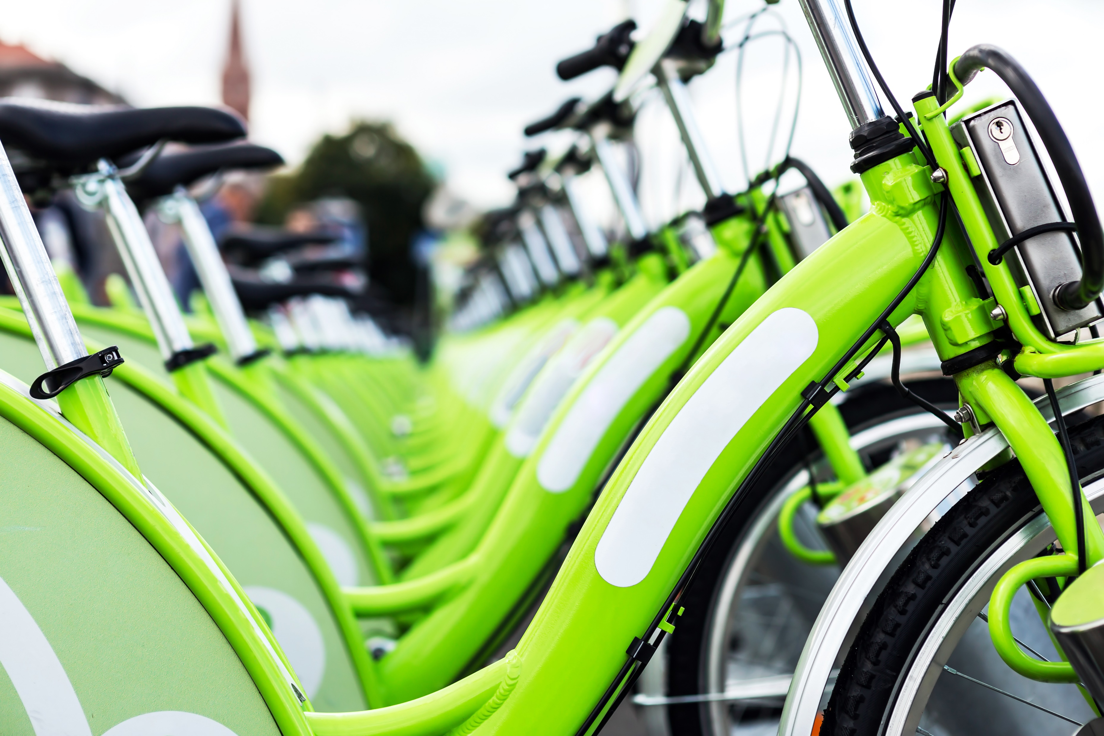
The End

